Slide 1
Why User InputValidation?
To Ensure that the incoming values are of the expected data type, that they are within the permitted range and that required values are present.

Slide 2
Demo1
In this demo, we are going to :
Download Demo1_validation
Run the application
Define an enumeration: Section with the following options:
IT , Business , Marketing and Economy
Now, the student belongs to one of these sections.
Use the Select element to select one option from the list of options
Try to create some students? Can you add 2 students?
Implement Singelton design pattern.

Slide 3
Where validate?
On the browser
Using client-side script or the browser's in-built data type validation
On the server.
Razor Pages supports a robust validation framework that works against inbound model properties on the client-side and on the server.

Slide 4
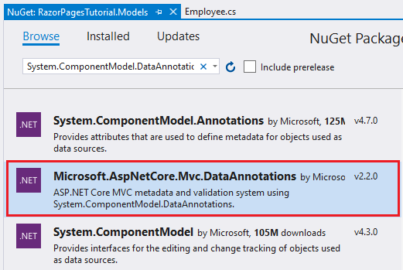
DataAnnotation Attributes
The primary building block of the validation framework is a set of attributes. Most of these attributes reside in the System.ComponentModel.DataAnnotations namespace that resides in Microsoft.AspNetCore.Mvc.Data Annotations NuGet package
.

Slide 5
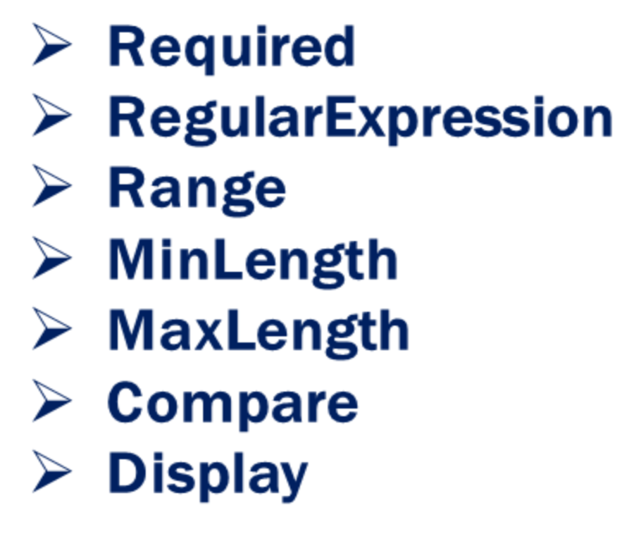
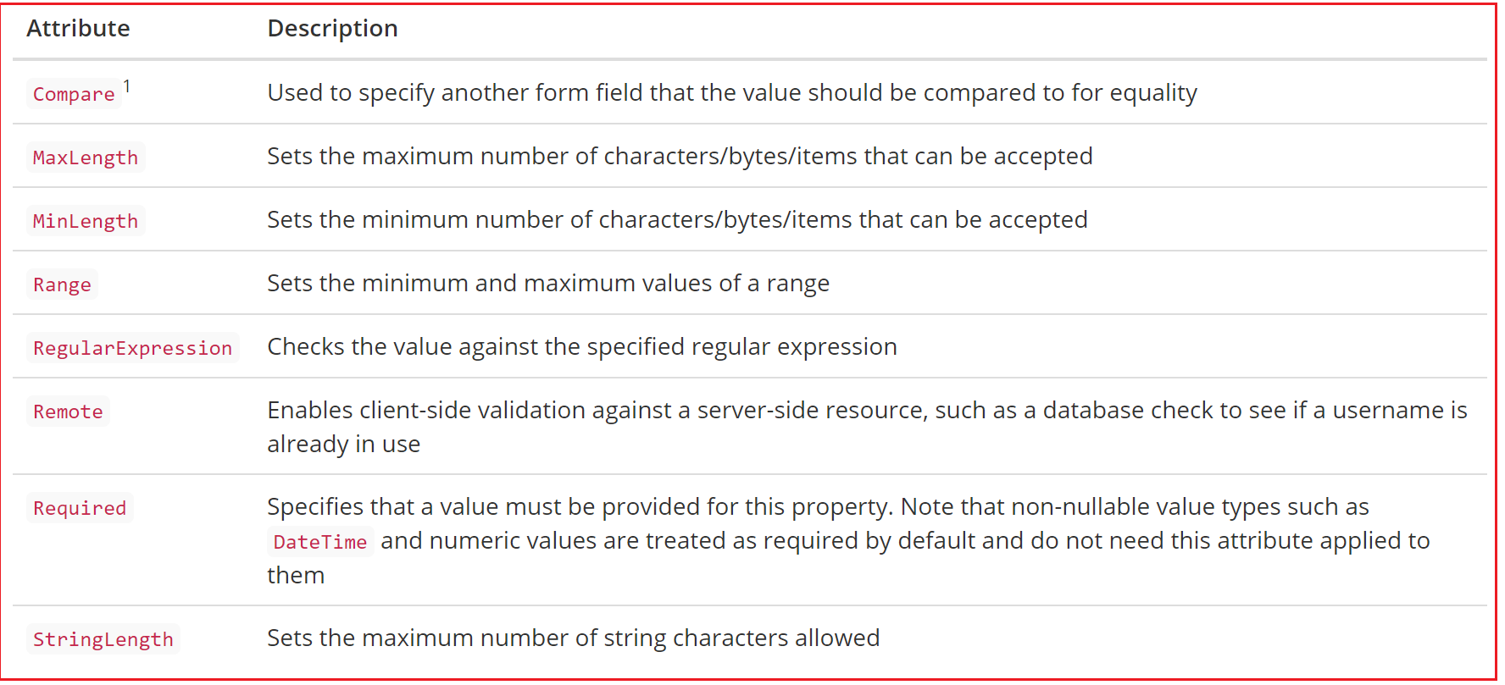
Built-in Validation Attributes

Slide 6
Server side validation
Server-side validation is included as part of the ASP.NET Core validation framework.
Once property values have been bound, the framework looks for all validation attributes on those properties and executes them.
Any failures result in an entry being added to a ModelStateDictionary - a dictionary-like structure where validation errors are stored.
This is made available in the PageModel class via ModelState, which has a property named IsValid that returns false if any of the validation tests fail .

Slide 7
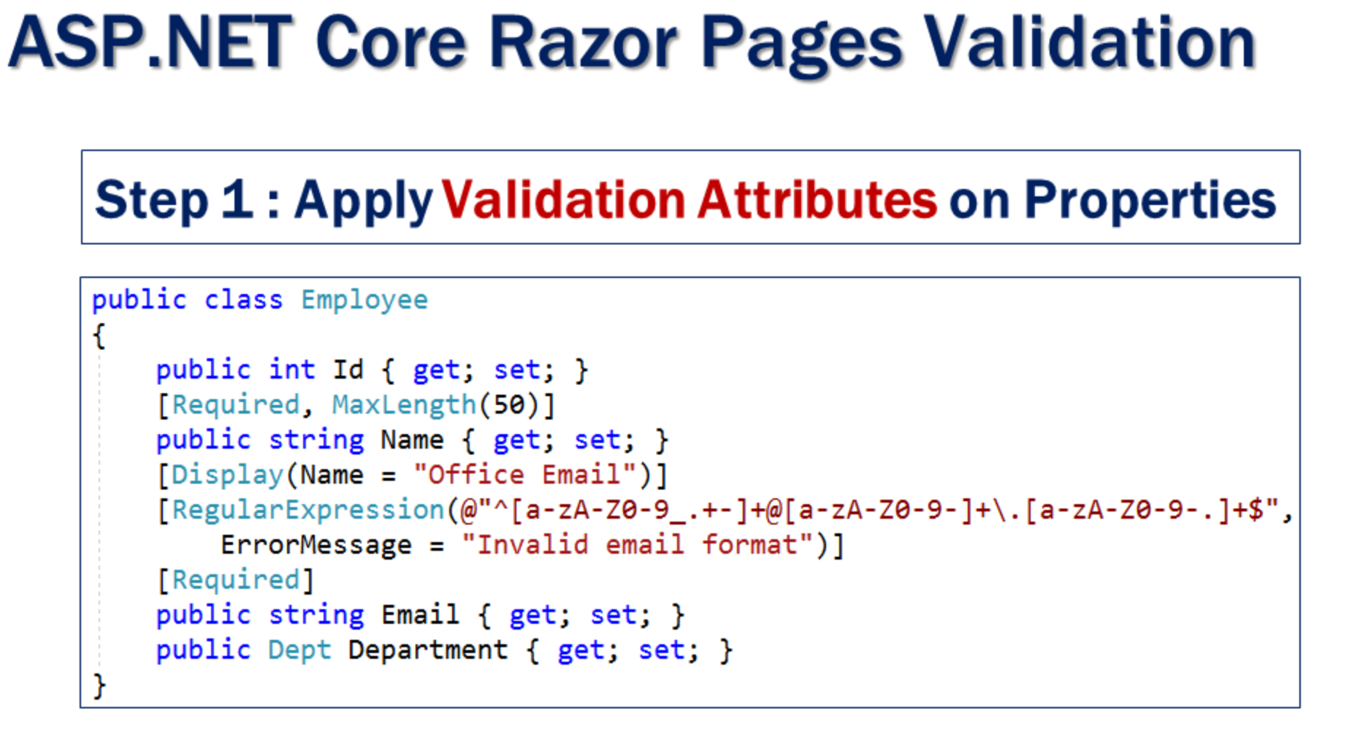

Slide 8
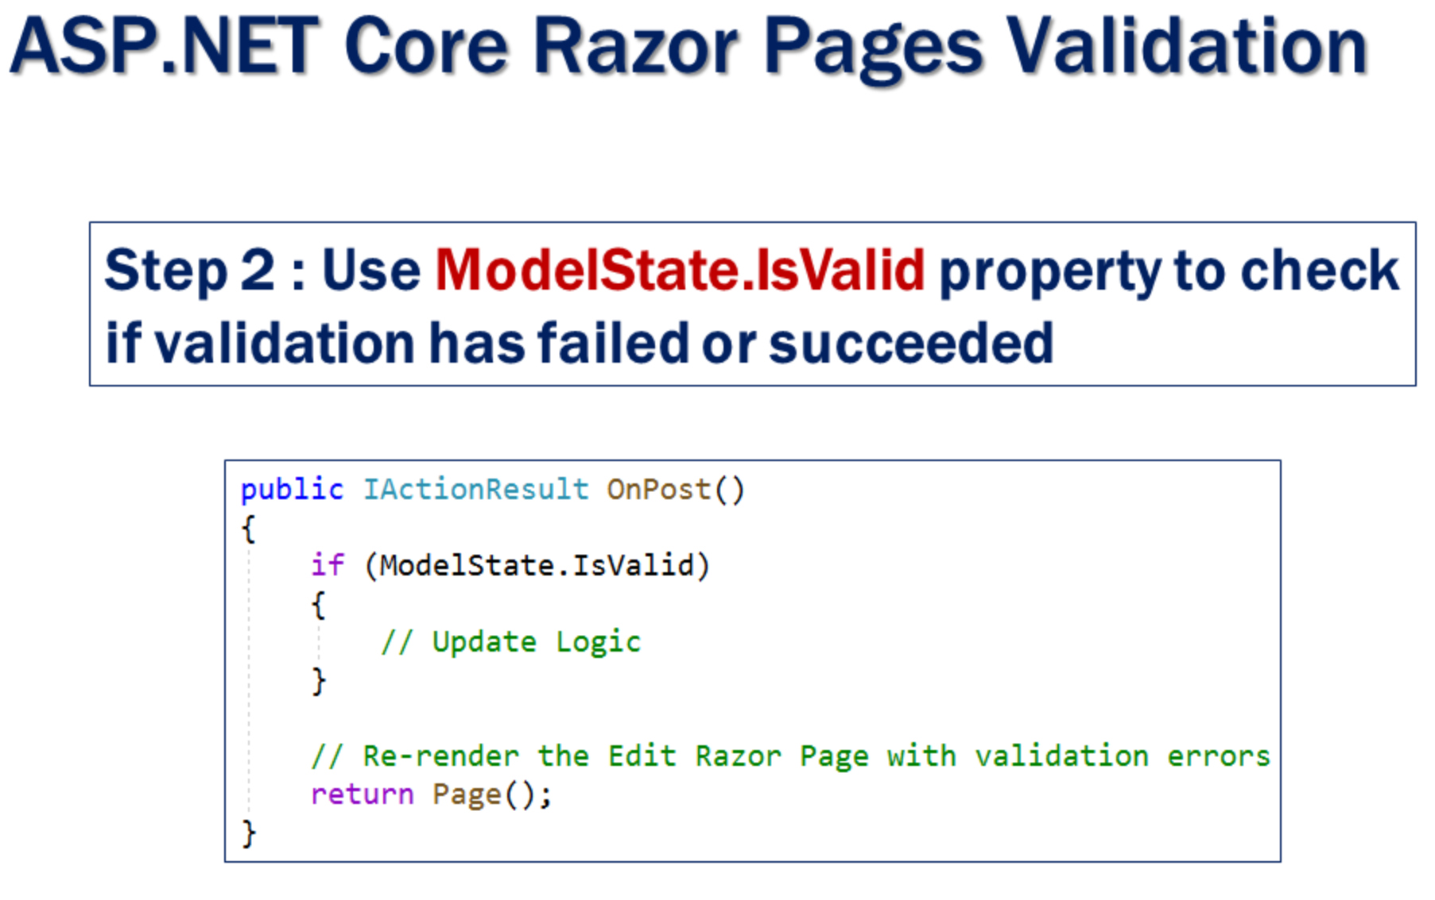

Slide 9
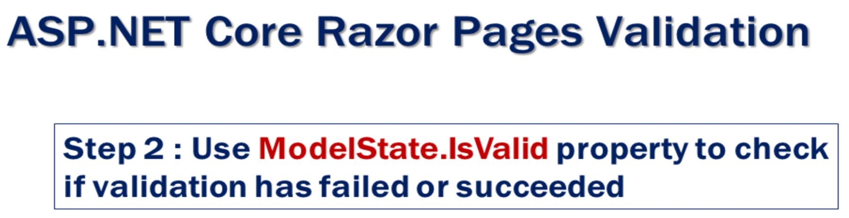
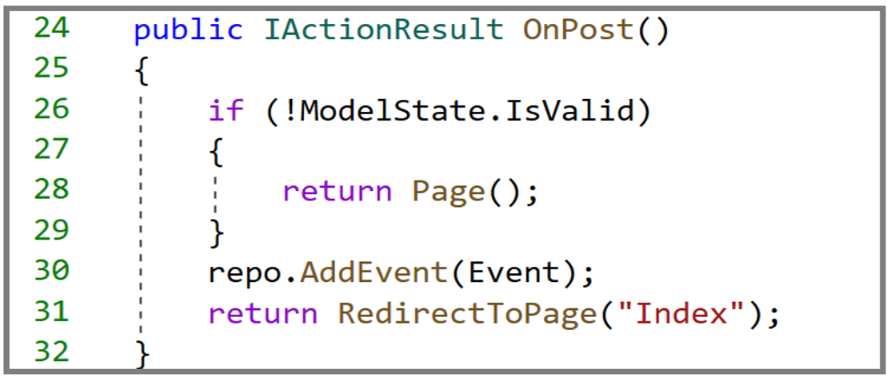
Check that the PageModel passes model validation using the ModelState.IsValid property.
If the PageModel passes model validation , add the model Event object to the list and redirect the user to the Index Razor page using the RedirectToPage() method.
3. Otherwise , re-display the form using Page(). Data will still be there, usefull when editing .

Slide 10
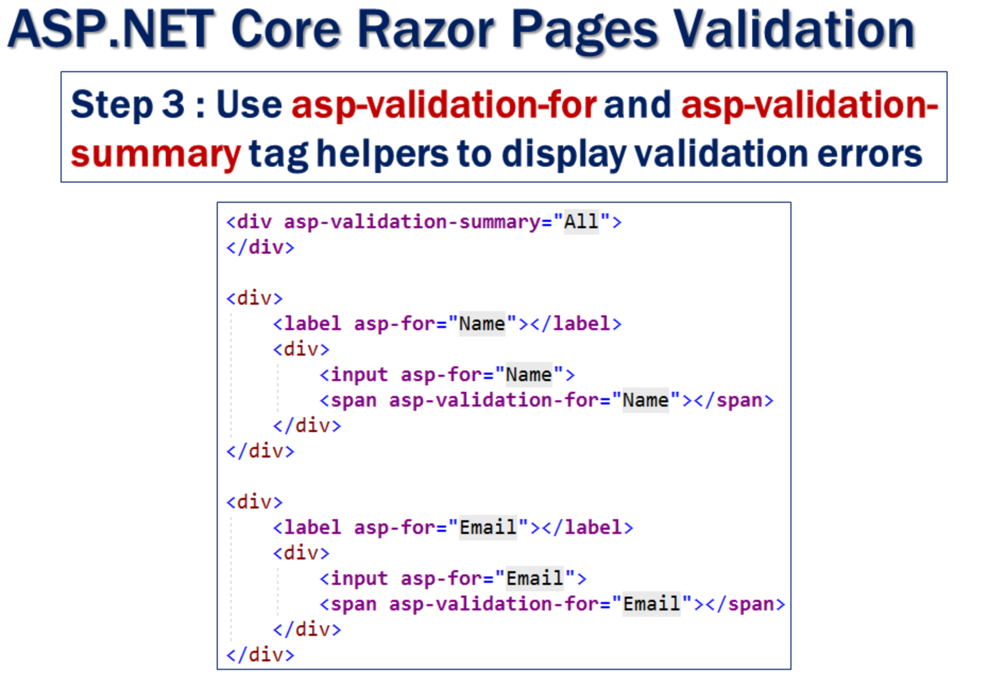

Slide 11
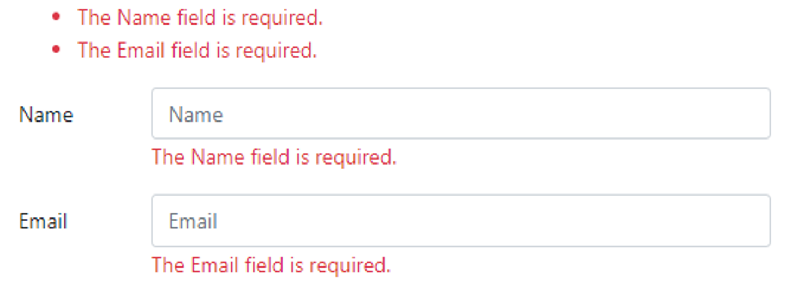
Server side validation
We want to make both Name and Email fields required.
If the required values are not provided and the razor page is submitted we want to display required validation errors as shown above.
To make a field, a required field, apply Required attribute on the corresponding property of the model class.

Slide 12
Demo2
In this demo, we are going to :
Implement validation
Step1: Apply validation attributes
Step2: use ModelState.IsValid property to check whether the vakidation fails or succeded
Step3: use asp-validation-for and asp-validation-summary
Try to enter 2 students having the same key

